Slide 1

Final Presentation
Project Conceptualization and Development
Project Title: Developing an AR Tool for Phobia treatment
Group: Alice & Bob
Practical assignment goal: Development of a MR application using a human-centered approach, specific devices and libraries.
RVA

Slide 2
Assignment 1
Project Conceptualization
Final Presentation - RVA 2019-2020
2

Slide 3
USE CONTENT FROM MID-TERM PRESENTATION
COPY SLIDES FROM INTRODUCTION TO PROJECT CONSTRAINS HERE!
Final Presentation - RVA 2019-2020
3

Slide 4
Assignment 2
Project Development
Final Presentation - RVA 2019-2020
4

Slide 5

Prototype Developed
Insert project title here
Present the main features of your solution according to your pre-defined list of requirements.
Use images and/or videos to contextualize.
Use as many slides as necessary.
Final Presentation - RVA 2019-2020
5

Slide 6
Architecture
Insert project title here
Only if it makes sense – not mandatory.
Present the main modules of your architecture.
Specify their purpose and connection to other modules.
Final Presentation - RVA 2019-2020
6

Slide 7
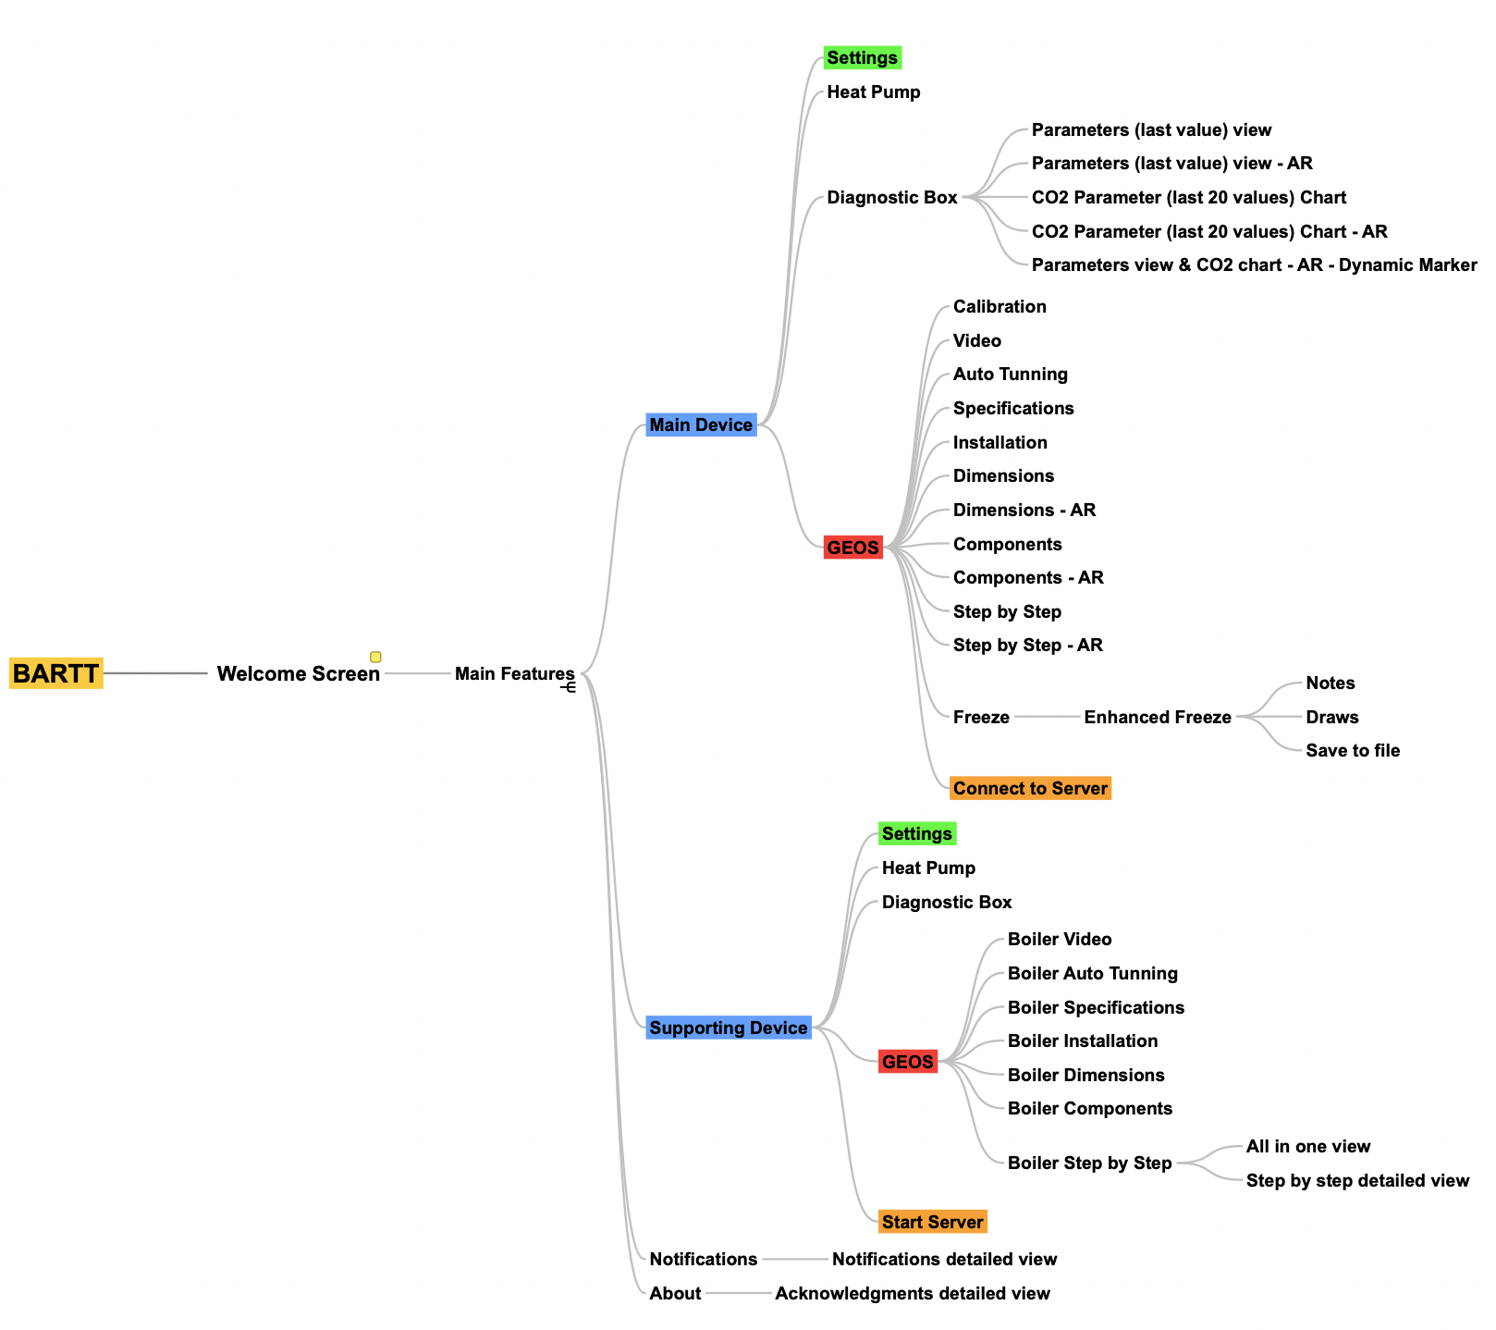
Project Structure
Insert project title here
Address how the information flows between scenes.
Present the structure of your Project implementation.
Final Presentation - RVA 2019-2020
7

Slide 8
Tools Used
Insert project title here
Present the main tools used.
What was the Game Engine?
Specify libraries used.
If you used 3D models – Mention their origin.
Add other tools you may have used (e.g. blender, …).
What hardware have you used?
Final Presentation - RVA 2019-2020
8

Slide 9
User Evaluation
Insert project title here
Only if performed – not mandatory.
Present the method used.
What was the goal? What do you want to evaluate?
Which persona were you addressing?
What where the tasks used?
Mention how many participants.
What questionnaires where used?
Present the main results based on Quantitative or Qualitative analysis.
Use charts or images to highlight main observations.
Present new features you may have identified in this process.
If you implement any new feature, present it, and compare the old and new versions.
Final Presentation - RVA 2019-2020
9

Slide 10
Demo Video
Insert project title here
Present the main features.
Use view from device and/or user.
Not longer than 60s. Suggestion: You can fast-forward video speed!
Final Presentation - RVA 2019-2020
10

Slide 11
Expectation vs Reality - Project Objectives
Insert project title here
Confront your high-level goals with your results
Did you achieve all your expected outcomes?
Did you manage to exceed your initial goals?
Final Presentation - RVA 2019-2020
11

Slide 12
Main difficulties
Insert project title here
Identify the main difficulties you felt during this project.
…
Final Presentation - RVA 2019-2020
12

Slide 13
Future work
Insert project title here
If you were to continue the project, what would be the next steps?
Specify at least 3.
Final Presentation - RVA 2019-2020
13

